Slide 1

CS-M151B
Computer Systems Architecture
Blaise Tine
UCLA Computer Science

Slide 2

Attendance

Slide 3
Homework #2
Questions 2 and 3 had a grading option error.
- fixed

Slide 4
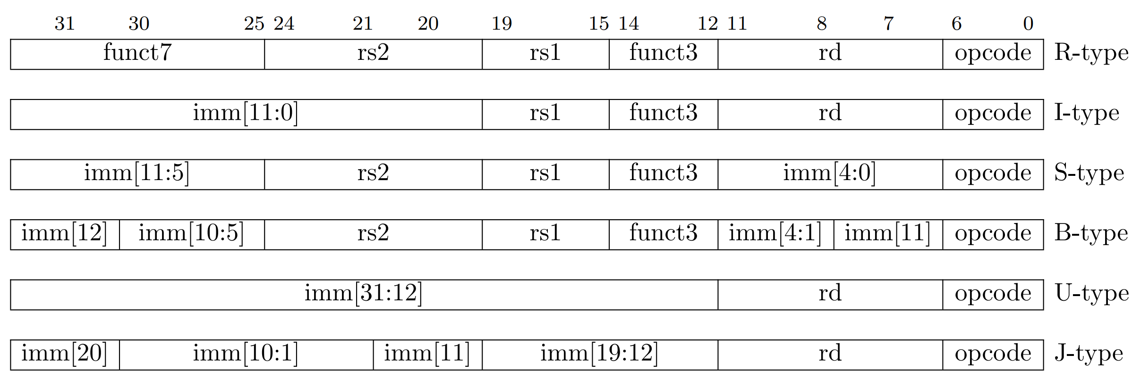
RISC-V Base Instruction Formats
Formats classified based on addressing mode and operation type
R-type: register
I-type: direct
S-type: store
B-type: branch
U-type: immediate
J-type: jump
Notes:
Jumps are unconditional branches

Slide 5
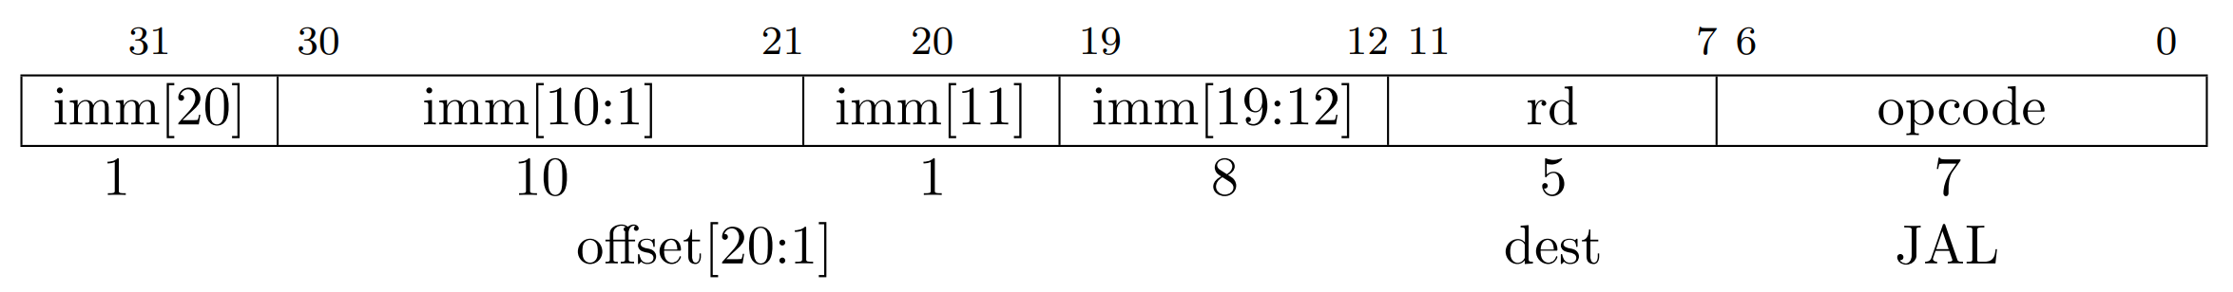
RISC-V Control transfer Instructions
JAL: Plain unconditional jumps
Target address = sign-extended 12-bit immediate
Link register rd
If (rd != 0) PC + 4 is written into rd
Notes:
Jumps are unconditional branches

Slide 6
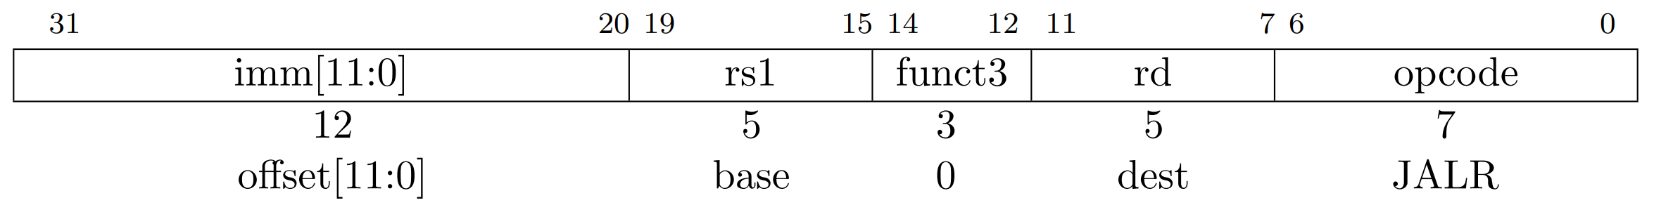
RISC-V Control transfer Instructions
JALR: indirect jump
Target address = sign-extended 12-bit immediate + src1
Link register rd
If (rd != 0) PC + 4 is written into rd
Notes:
Jumps are unconditional branches

Slide 7
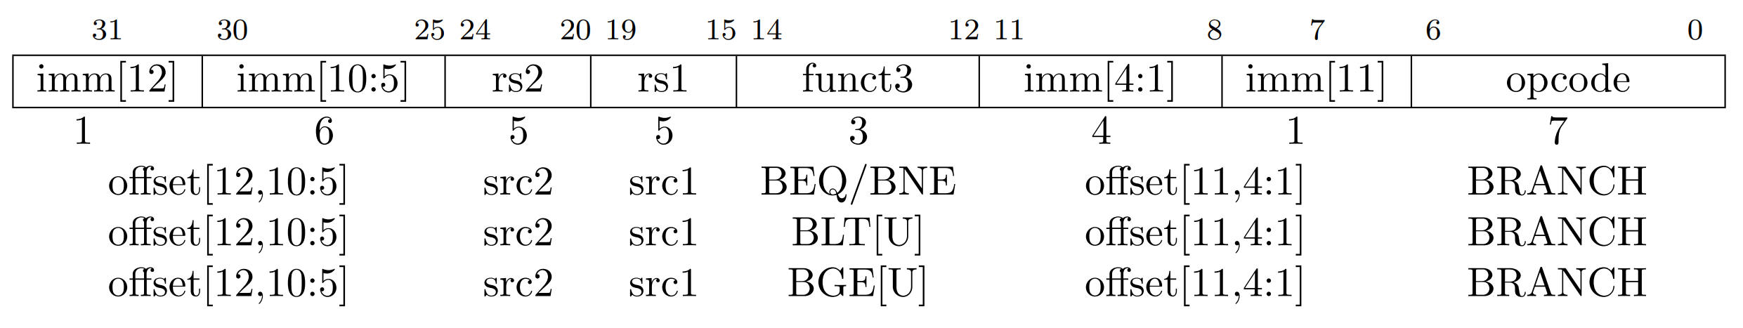
RISC-V Control transfer Instructions
Conditional branches
Compare rs1 and rs2
Target address = sign-extended 12-bit immediate + PC
Notes:
Jumps are unconditional branches

Slide 8
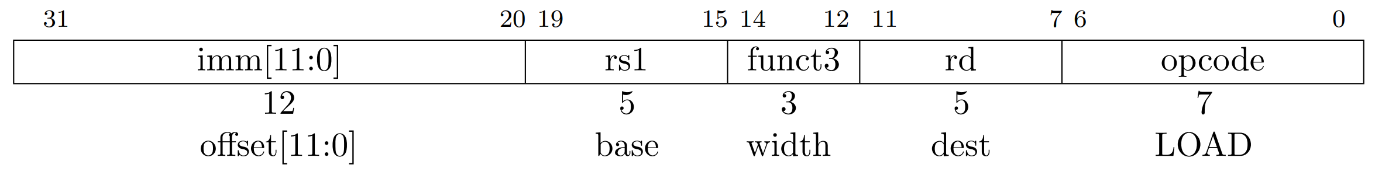
RISC-V Load and Store instructions
LOAD: load value from memory
Rd = MEM[base + offset]
Width = size of word
LB: 000
LH: 001
LW: 010
LBU: 100 (unsigned)
LHU: 101 (unsigned)
LWU: 110 (unsigned)
←Notice anything about MSB value?
Notes:
Jumps are unconditional branches

Slide 9
RISC-V Load and Store instructions
Problem:
Given a 32-bit RISC-V CPU, consider you have a memory segment starting at address 0x10010000, and you need to load an unsigned byte located at address 0x1001002A into register x5. Use x2 as your base address.
Q1: Write the assembly code for this load instruction
Q2: Write the instruction code for this load instruction
Notes:
Jumps are unconditional branches

Slide 10
RISC-V Load and Store instructions
Q1 Solution:
Target address: 0x1001002A
Base address: 0x10010000
Offset: 0x1001002A - 0x10010000 = 0x2A = 42
Which width mode to use?
LBU (100)
Assembly:
lbu x5, 42(x2)
Notes:
Jumps are unconditional branches

Slide 11
RISC-V Load and Store instructions
Q1 Solution:
We also need to update x2 with base address 0x10010000
Which format can we choose?
Let’s try Load upper immediate
Notes:
Jumps are unconditional branches

Slide 12
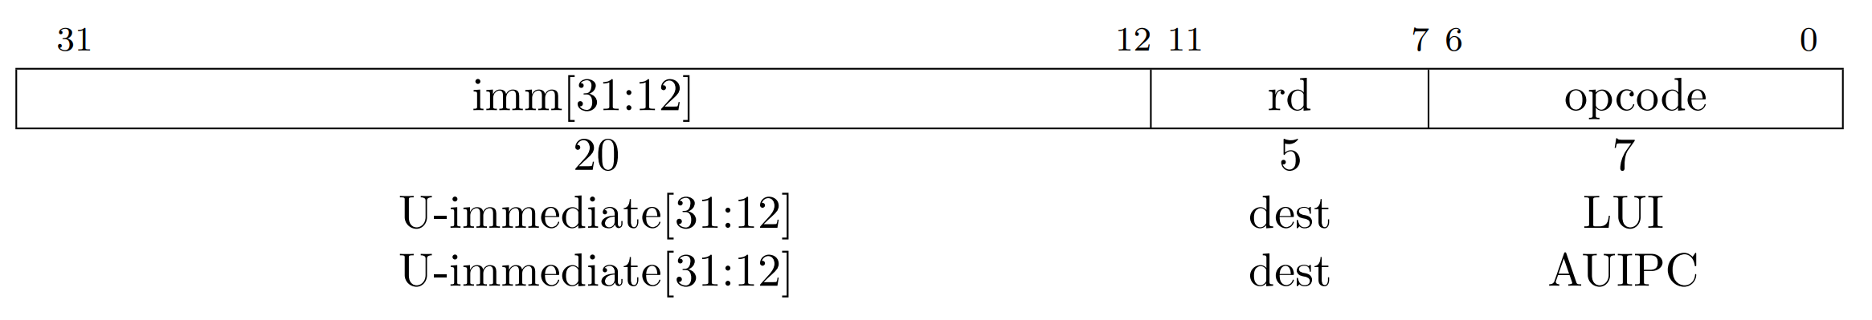
RISC-V Load and Store instructions
Q1 Solution:
Load upper immediate
Move upper 20-bits
0x10010000
shifted right by 12 = 0x10010
Assembly: lui x2, 0x10010
Notes:
Jumps are unconditional branches

Slide 13
RISC-V Load and Store instructions
Q2: Solution
Opcode: 0000011
rd: The destination register, x5, in binary is 00101.
func3: 100 (for LBU)
rs1: The base register, x2, in binary is 00010.
imm[11:0]: The offset 0x2A in 12-bit binary is 000000101010.
Instruction code: 000000101010-00010-100-00101-0000011
Instruction code: 0x02A14503
Notes:
Jumps are unconditional branches

Slide 14
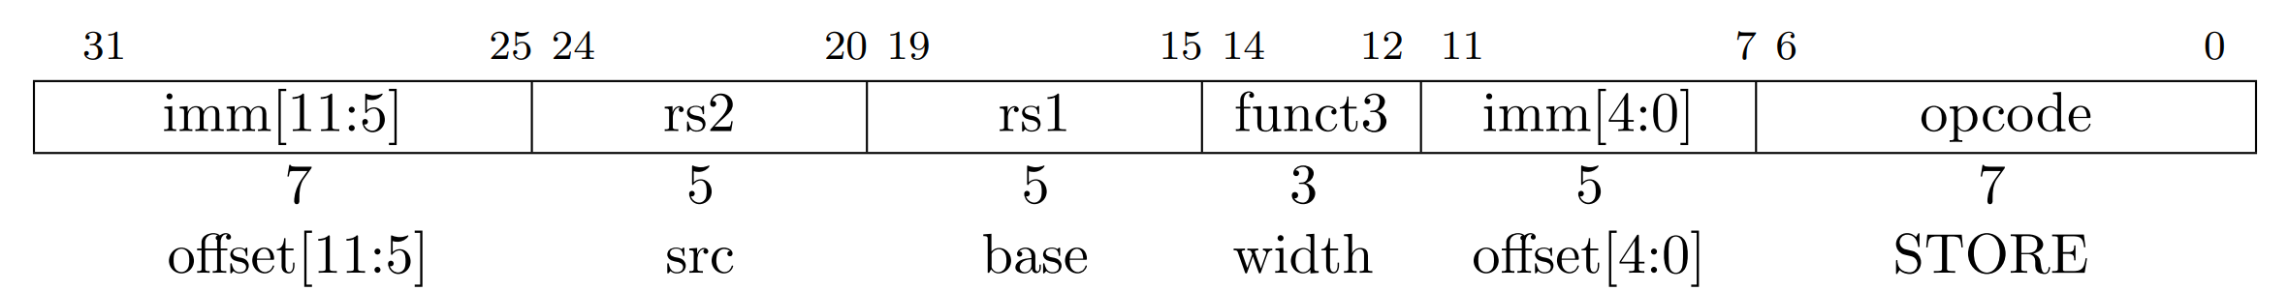
RISC-V Load and Store instructions
STORE: store value to memory
MEM[base + offset] = src
Width = size of word
SB: 000
SH: 001
SW: 010
<- No unsigned variants?
Notes:
Jumps are unconditional branches

Slide 15
RISC-V Load and Store instructions
Problem:
Given a 32-bit RISC-V CPU, consider you have a memory segment starting at address 0x10010000, and you need to store a half-word from register x10 into memory address 0x1001002C. Use x2 as your base address.
Q1: Write the assembly code for this load instruction
Q2: Write the instruction code for this load instruction
Notes:
Jumps are unconditional branches

Slide 16
RISC-V Load and Store instructions
Q1 Solution:
Target address: 0x1001002C
Base address: 0x10010000
Offset: 0x1001002C - 0x10010000 = 0x2C = 44
Which width mode to use?
SH (001)
Assembly: sh x10, 44(x2)
Notes:
Jumps are unconditional branches

Slide 17
RISC-V Load and Store instructions
Q2: Solution
opcode: 0100011 (for S-type store operations)
imm[11:5]: Upper 7 bits of the offset 0x2C in binary is 0000010.
rs2: The source register x10 in binary is 01010.
rs1: The base register x2 in binary is 00010.
func3: 001 (for SH)
imm[4:0]: Lower 5 bits of the offset 0x2C in binary is 01100.
Instruction code: 0000 010-01010-00010-001-01100-0100011
Instruction code: 0x02A1C23
Notes:
Jumps are unconditional branches

Slide 18
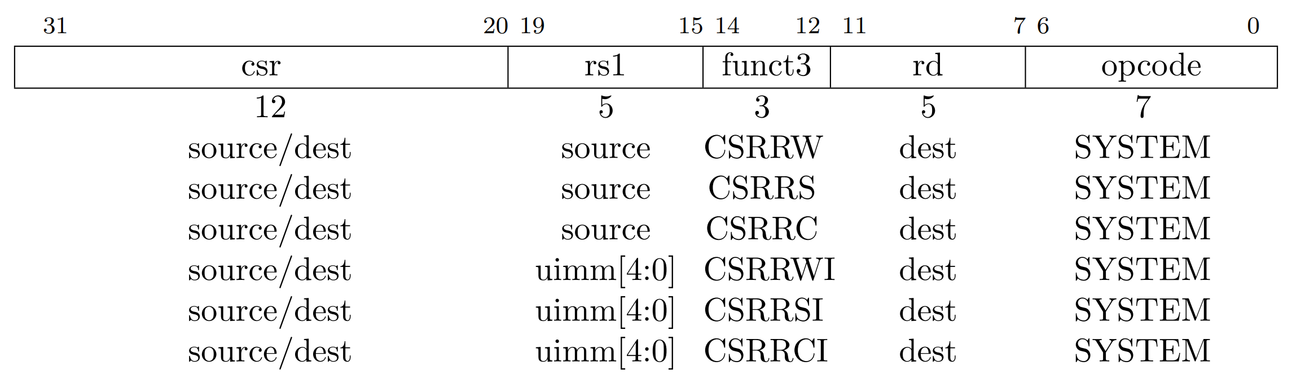
RISC-V Control and Status Instructions
Read/Write to CSRs
#csr = address to 12-bit CSR table
CSRRW: atomic read/write: csr_new = source, dest = csr_old
CSRRS: atomic read set: csr_new = csr_old | source , dest = csr_old
CSRRC: atomic read & clear: csr_new = csr_old & ~source , dest = csr_old
Notes:
Jumps are unconditional branches

Slide 19
RISC-V Control and Status Instructions
Read/Write to CSRs
#csr = address to 12-bit CSR table
CSRRWI: atomic read/write: csr_new = uimm, dest = csr_old
CSRRSI: atomic read set: csr_new = csr_old | uimm , dest = csr_old
CSRRCI: atomic read & clear: csr_new = csr_old & ~ uimm , dest = csr_old
Notes:
Jumps are unconditional branches

Slide 20
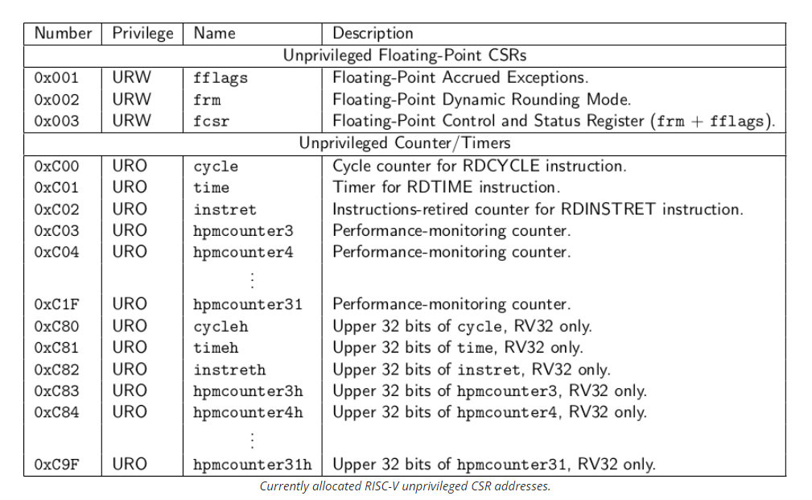
RISC-V Control and Status Instructions
User-level CSR Table
Standard mapping
FPU flags
Cycle
Time
Instret
HPM Counters
Notes:
HPM: hardware performance monitoring counter

Slide 21
RISC-V Control and Status Instructions
Problem:
Write a RISC-V assembly instruction to read the value of the utime CSR, which holds the machine-mode timer's current value, and store it into general-purpose register x5.
Notes:
Jumps are unconditional branches

Slide 22
RISC-V Control and Status Instructions
Solution:
Read-only: CSRRS with x0
Time CSR address: 0xC01.
Destination register: x5
Assembly: csrrs x5, 0xC01, x0
Notes:
Jumps are unconditional branches

Slide 23
RISC-V Control and Status Instructions
Privilege Levels: defines the level of access that software has to the processor and system resources. They enable:
Access control: control what an application can do
Security: run an application in isolation from others
Notes:
Jumps are unconditional branches

Slide 24
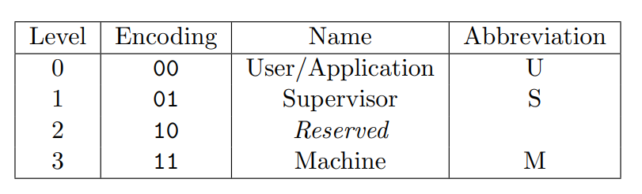
RISC-V Control and Status Instructions
RIS-V Privilege Levels
User-level (U)
Hypervisor (H)
Supervisor (S)
Machine-level (M)
Hypervisor
H
Notes:
Jumps are unconditional branches

Slide 25
RISC-V Control and Status Instructions
User-level (U): User-level CSRs are accessible from the user mode, which is the least-privileged mode of operation. These registers typically contain information or controls that are safe to expose to user applications, such as performance counters that can be read without compromising system integrity.
Notes:
Jumps are unconditional branches

Slide 26
RISC-V Control and Status Instructions
Hypervisor-level (H): Hypervisor mode is an optional privilege level introduced in newer versions of the RISC-V specification, designed for virtualization. It sits between M-mode and S-mode and is used to run and manage virtual machines.
Notes:
Jumps are unconditional branches

Slide 27
RISC-V Control and Status Instructions
Supervisor-level (S): Supervisor mode is used by operating systems to control system resources and manage user applications. It has a lower privilege than M-mode but can still perform system-level tasks.
Notes:
Jumps are unconditional branches

Slide 28
RISC-V Control and Status Instructions
Machine-level: Machine-level CSRs are accessible from machine mode, which is the most privileged mode of operation. These registers are used for controlling low-level, sensitive aspects of the hardware, such as interrupt handling, exception handling, and access to physical memory.
Note: default level for low-level embedded CPUs
Notes:
Jumps are unconditional branches

Slide 29
RISC-V Control and Status Instructions
How is the privilege level set/modified?
CPU starts at machine level (M)
S/W can use CSR mstatus can be used to lower the privilege level
CPU can use exception handling to increase the privilege level
RISC-V mret, sret, uret are system return instructions for switching back to previous privilege level.
Notes:
Jumps are unconditional branches

Slide 30
RISC-V Control and Status Instructions
How is the privilege level enforced?
If software running at a lower privilege level attempts to execute a privileged instruction, protected address space, or privileged interrupt, the processor raises an exception
Notes:
Jumps are unconditional branches

Slide 31
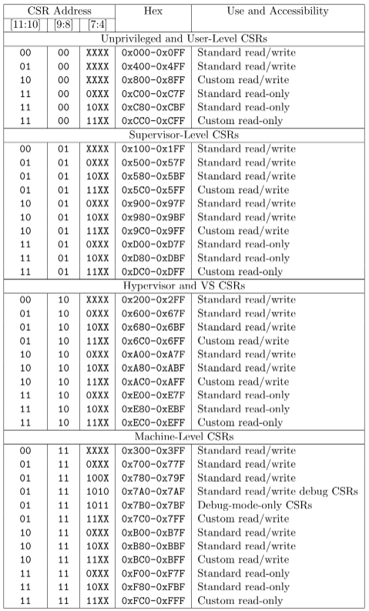
RISC-V Control and Status Instructions
CSR Privilege Mapping
Why reserving dedicated bits for level?
Notes:
Jumps are unconditional branches

Slide 32
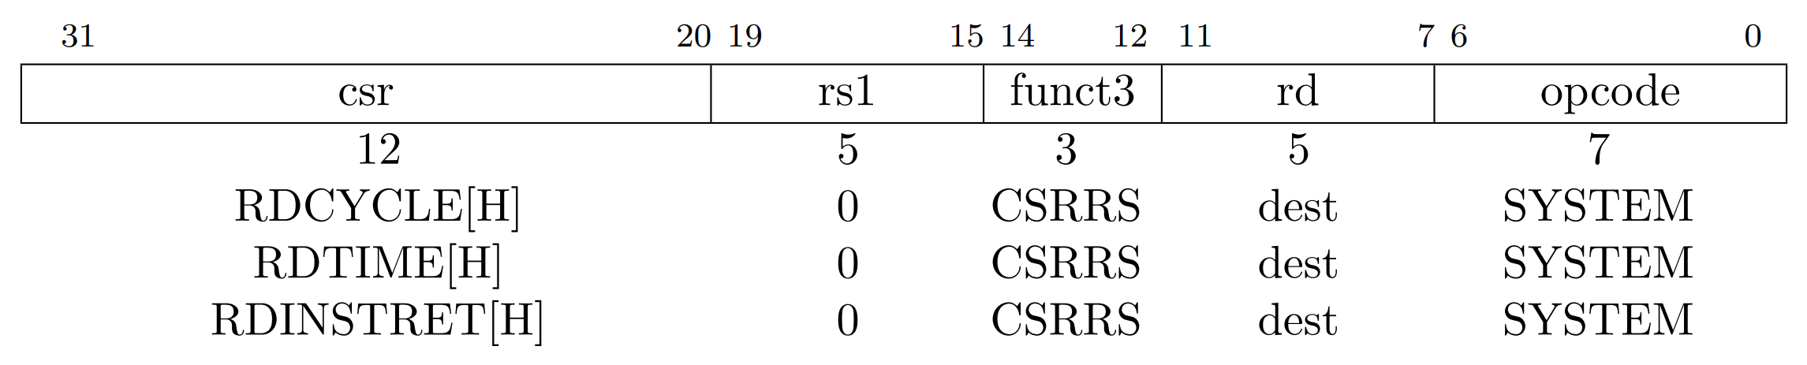
RISC-V Control and Status Instructions
Timers and counters
64-bit registers
RD_CYCLE: total cycle time
RD_TIME: wall-clock time
RD_INSTRET: total instructions
Notes:
walltime is the actual time taken from the start of a computer program to the end

Slide 33
RISC-V Control and Status Instructions
Timers and counters
How to read RD_CYCLE on 32-bit machine?
Why could this be challenging?
Counter 32-bit overflow
Solution
Read Low 32-bit
Read high 32-bit
Notes:
walltime is the actual time taken from the start of a computer program to the end

Slide 34
RISC-V Control and Status Instructions
Assembly code
csrrs x2, cycle, x0
csrrs x3, cycleh, x0
What timing issue may emerge from the above code?
x2 and x3 may not match
Hundreds of CPU cycles can happen between the two calls
Reading cycleh could happen after cycle 32-bit overflow
Notes:
walltime is the actual time taken from the start of a computer program to the end

Slide 35
RISC-V Control and Status Instructions
Solution
loop: csrrs x3, cycleh, x0
csrrs x2, cycle, x0
csrrs x4, cycleh, x0
bne x3, x4, loop
How does this work?
It takes a while for cycleh change
The loop handle the overflow cases
Notes:
walltime is the actual time taken from the start of a computer program to the end

Slide 36
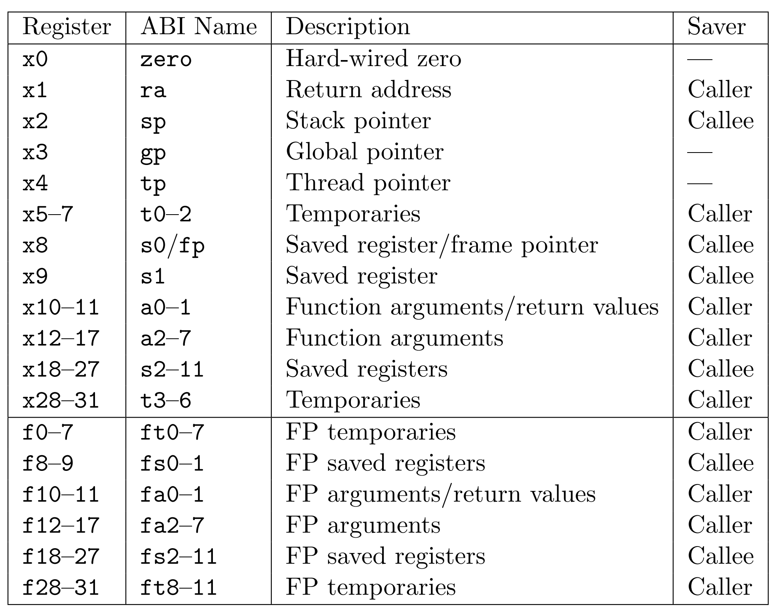
RISC-V Registers
32 general-purpose registers
Separate floating-point registers
Register r0=0x0 - why?
Hidden PC register
accessible via CSRs only
Notes:
Why Zero?
- predominant value for comparisons and arithmetic operations
- simple instruction decoding when no registers is needed
- simple register file access logic when no register is needed

Slide 37
RISC-V Registers
ABI Calling convention:
Arguments: a0-7
Return: r0
Temporaries: t0-6
Saved registers: s0-11
Who back up registers during calls?
Caller/parent
or Callee/child
Notes:
Why Zero?
- predominant value for comparisons and arithmetic operations
- simple instruction decoding when no registers is needed
- simple register file access logic when no register is needed

Slide 38
RISC-V Registers
Return address (ra)
Store the return address during function calls
Hold the next PC of the caller
Example: what is the value of ra when bar() is executing?
void bar() {
<print(“hello”);>
}
void foo() {
bar(); // call bar()
<print(“world\n”);>
}
# foo
0F00: ???
0F04: ???
0F08: jal ra, 0xF80
0F0C: ???
…
# bar
0F80: ???
0F84: ???
0F88: ???
0F8C: jalr x0, 0(ra)
Notes:
ra will hold the next instruction address when calling jal.

Slide 39
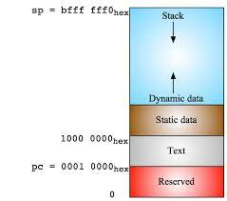
RISC-V Registers
Stack pointer (sp)
Used for managing function call stack.
The stack holds function’s temp variables that could not fit into registers.
Initialized to a starting location at boot time.
CPU determines the stack base address STACK_BASE_ADDR
la is a “load address” pseudo instruction
resolve to one or multiple RISC-V native instructions
depending on address value
# stack initialization
la gp, STACK_BASE_ADDR
Notes:
ra will hold the next instruction address when calling jal.

Slide 40
RISC-V Registers
Stack pointer (sp)
Example: A program uses 16 bytes of stack storage.
# Assume that x5 and x6 contain values that we want to preserve
# First, we'll adjust the stack pointer to allocate 8 bytes of space
addi sp, sp, -8 # Decrement the stack pointer by 8 bytes
# Now we'll store x5 and x6 onto the stack at the allocated space
sw x5, 0(sp) # Store x5 at the beginning of the allocated space
sw x6, 4(sp) # Store x6 right after x5
# ... the code can now use x5 and x6 for other operations…
add x5, x0, x1
add x6, x0, x1
# To restore the values of x5 and x6, we'll load them back from the stack
lw x5, 0(sp) # Load x5 from the stack
lw x6, 4(sp) # Load x6 from the stack
# Finally, we'll adjust the stack pointer back to free the 8 bytes
addi sp, sp, 8 # Increment the stack pointer by 8 bytes to restore its original value
Notes:
ra will hold the next instruction address when calling jal.

Slide 41
RISC-V Registers
Global pointer (gp)
Points to the middle of a global data segment
Why the middle?
Reduces instruction’s immediate value when accessing to global variables
Initialized to a starting location at boot time.
Linker exports macro __global_pointer for a given program.
la is a “load address” pseudo instruction
resolve to one or multiple RISC-V native instructions
depending on address value
# stack initialization
la gp, __global_pointer
Notes:
ra will hold the next instruction address when calling jal.

Slide 42
RISC-V Registers
Global pointer (gp)
Example
.data
array: .word 0, 1, 2, 3, 4
.text # Assuming gp points to `array`
lw t0, 0(gp) # Loads the first element of `array` into t0
Notes:
ra will hold the next instruction address when calling jal.

Slide 43
RISC-V Registers
Thread pointer (tp)
used to efficiently access thread-local storage (TLS)
TLS holds data unique to each thread in a multi-threading environment
Initialized to a starting location at boot time for each thread
# Assuming the thread-specific variable is at offset 0x10 from the thread pointer
lw t0, 16(tp) # Load the thread-specific variable into register t0
Notes:
ra will hold the next instruction address when calling jal.

Slide 44
RISC-V Registers
Thread pointer (tp)
used to efficiently access thread-local storage (TLS)
TLS holds data unique to each thread in a multi-threading environment
Initialized to a starting location at boot time.
__tcb_aligned_size is assigned by linker
csrr t0, VX_CSR_MHARTID
sll t1, t0, STACK_LOG2_SIZE #
sub sp, sp, t1
# set thread pointer register
# use address space after BSS region
# ensure cache line alignment
la t1, __tcb_aligned_size # allocated TLS size
mul t0, t0, t1
la tp, _end + 63
add tp, tp, t0
and tp, tp, -64
ret
Notes:
ra will hold the next instruction address when calling jal.

